Slide 1
What the Chirp?
EEP 596 SPRING 2024
Aeden Jameson, Vinayak Gaur, Levi Riley, Mike Lui

Slide 2
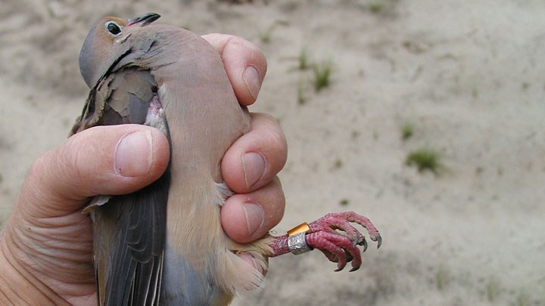
Introduction:
Birds are a class of feathered bipeds indigenous to all major continents. They play important roles in conservation and agriculture; in the former where they are present in several ecological niches and in the latter where they serve both as species to control pests as well as pest species themselves.
Currently, monitoring of birds is done through tagging during catch and release, or reports of sightings. Both of which are time-consuming and require specialized knowledge.

Slide 3
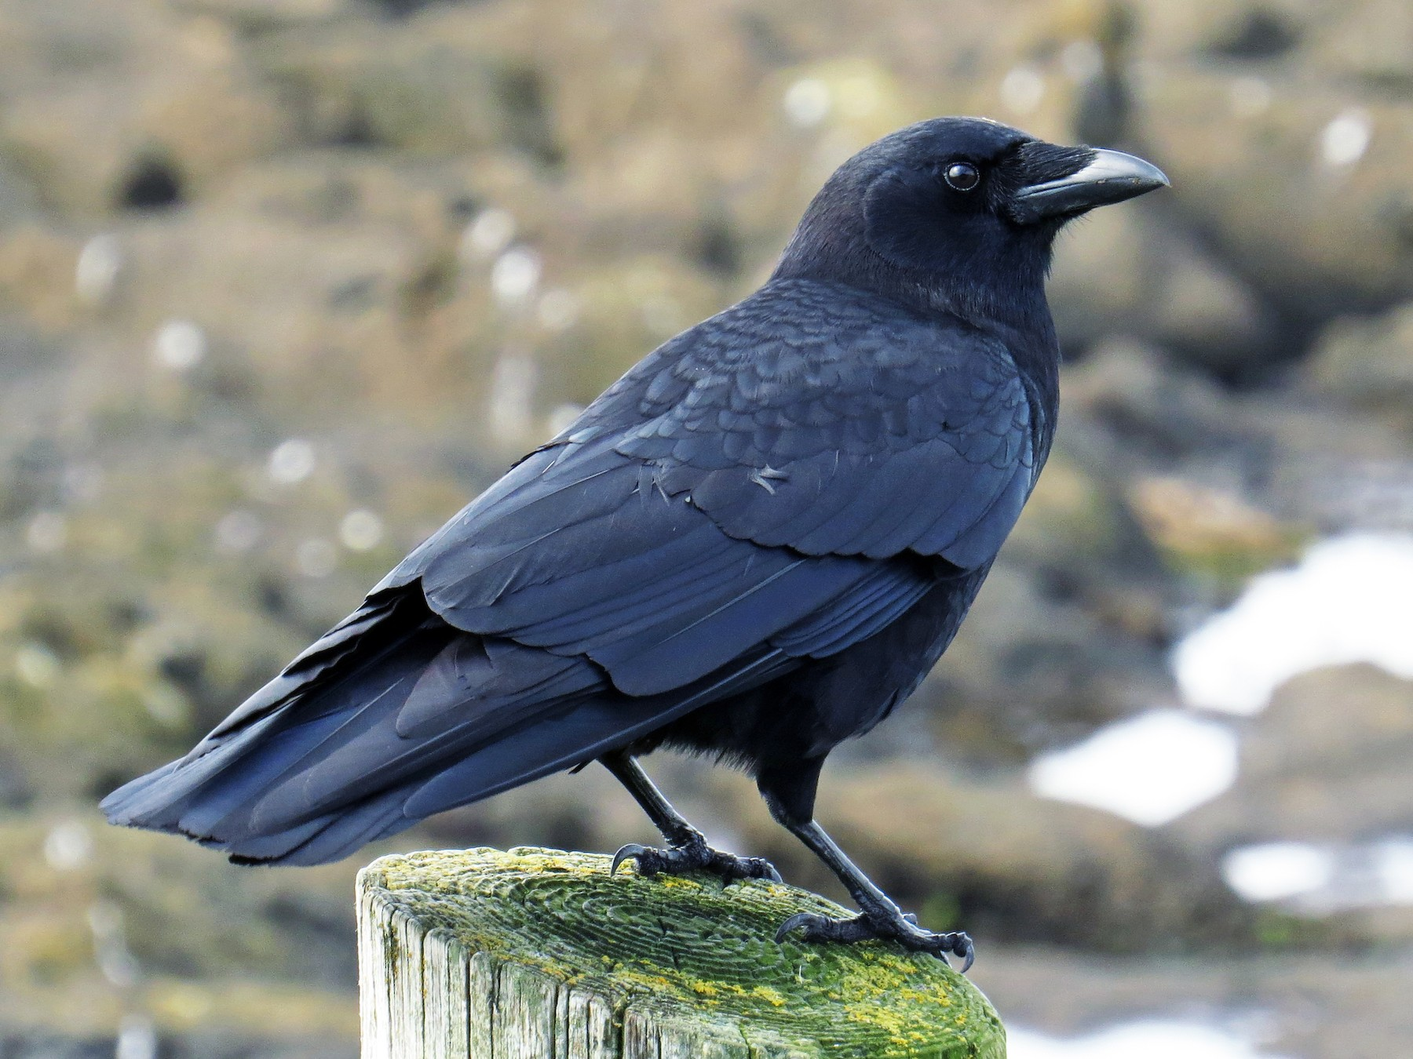
Objective:
To develop a non-invasive, efficient, and scalable system to monitor birds by remotely recording their songs. This system aims to gather data on bird presence, population trends, and behavior without the drawbacks associated with direct handling.

Slide 4
Methodology – Data Collection
A small collection of bird songs, and no calls, from 5 species: Bewick's Wren, Northern Cardinal, American Robin, Song Sparrow, Northern Mockingbird from https://www.kaggle.com/datasets/vinayshanbhag/bird-song-data-set, which was derived from The Cornell Bird Call dataset.

Slide 5
Methodology – Data Preprocessing
The original sound files were trimmed to 2.5 seconds and sampled from the original 22050 hz to 16000 hz to work the the Arduino device
The raw Wav files were converted into Mel-filterbank energies. Details can be found in Section A of the appendix.

Slide 6
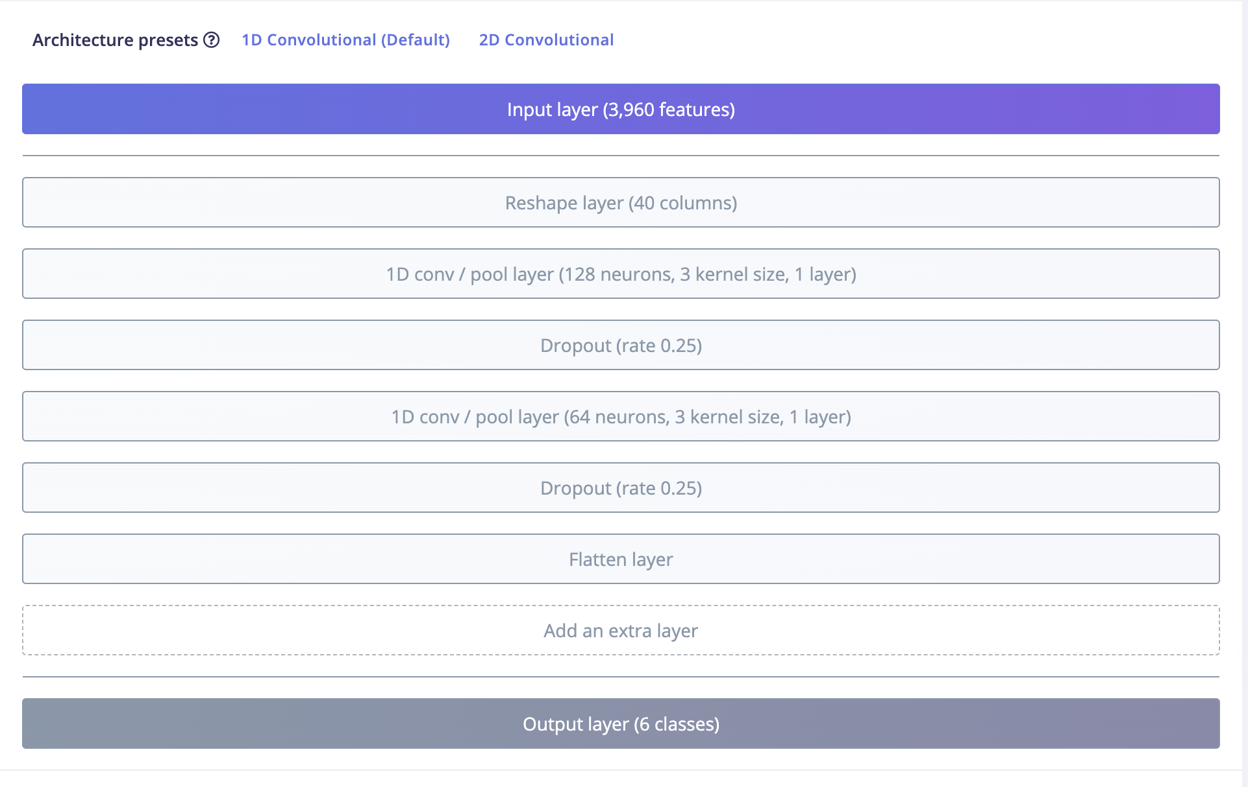
Model design
The model consists of an input layer followed by two pointwise convolutional layers and an output layer. The model was quantized using 8-bit integer quantization.
Model Size: 82.2KB
Avg. Inference Time: 348 ms.
Epochs: 100
Learning Rate: .001
Batch Size: 128
Notes:
IF ASKED, Why didn’t we do pruning? Early in model development we did, but due to difficulty in understanding how to get those models working with Arduino we abandoned Colab for model development and used Edge Impulse which doesn’t have pruning to our knowledge

Slide 7
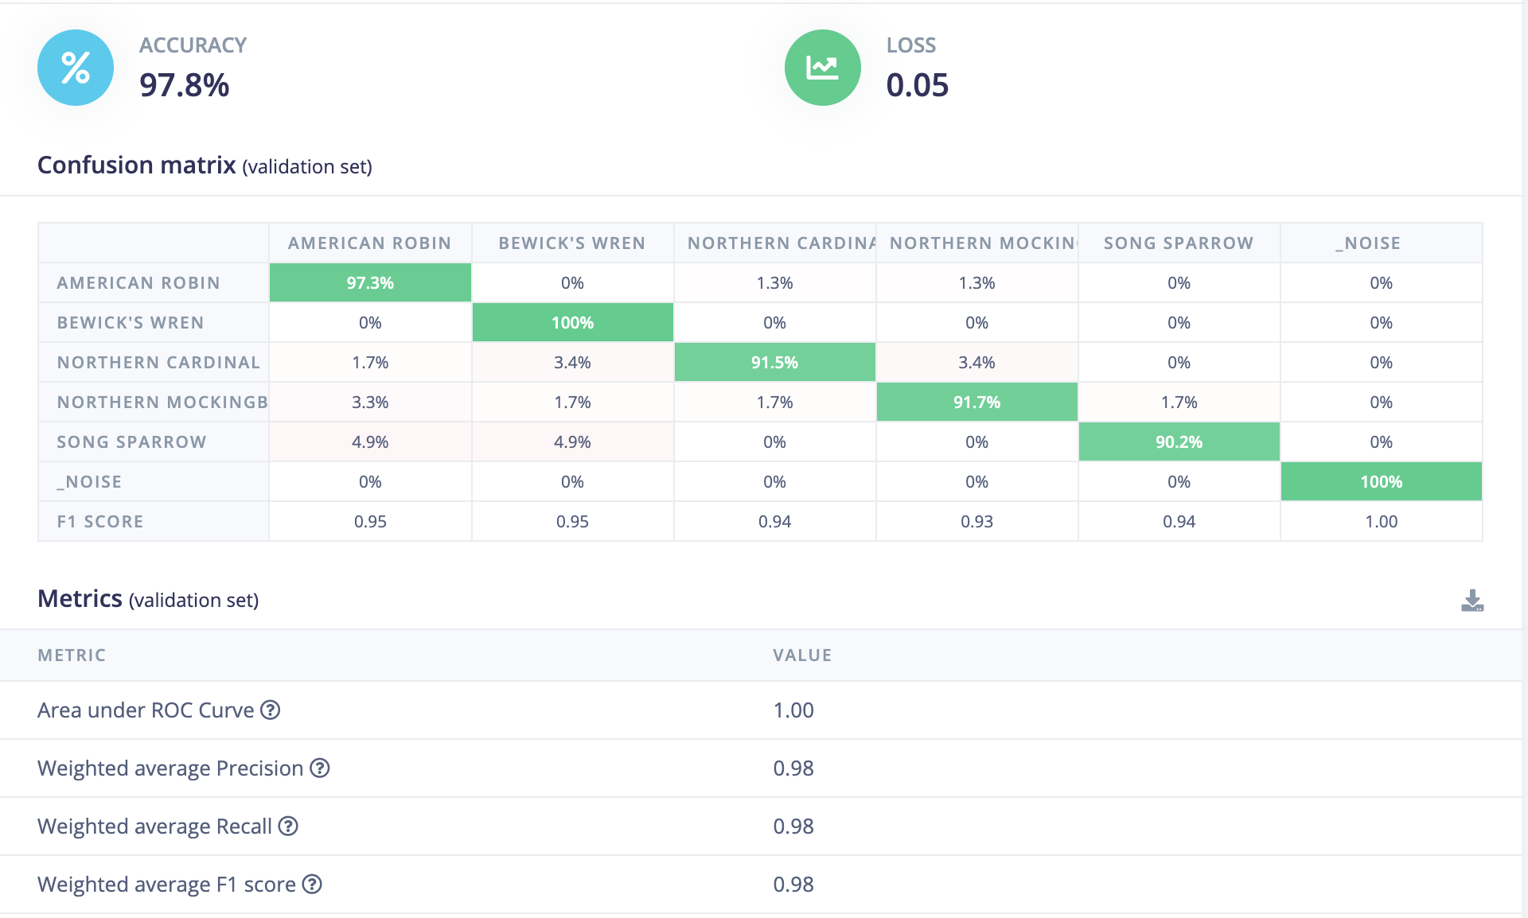
Model Performance - Validation

Slide 8
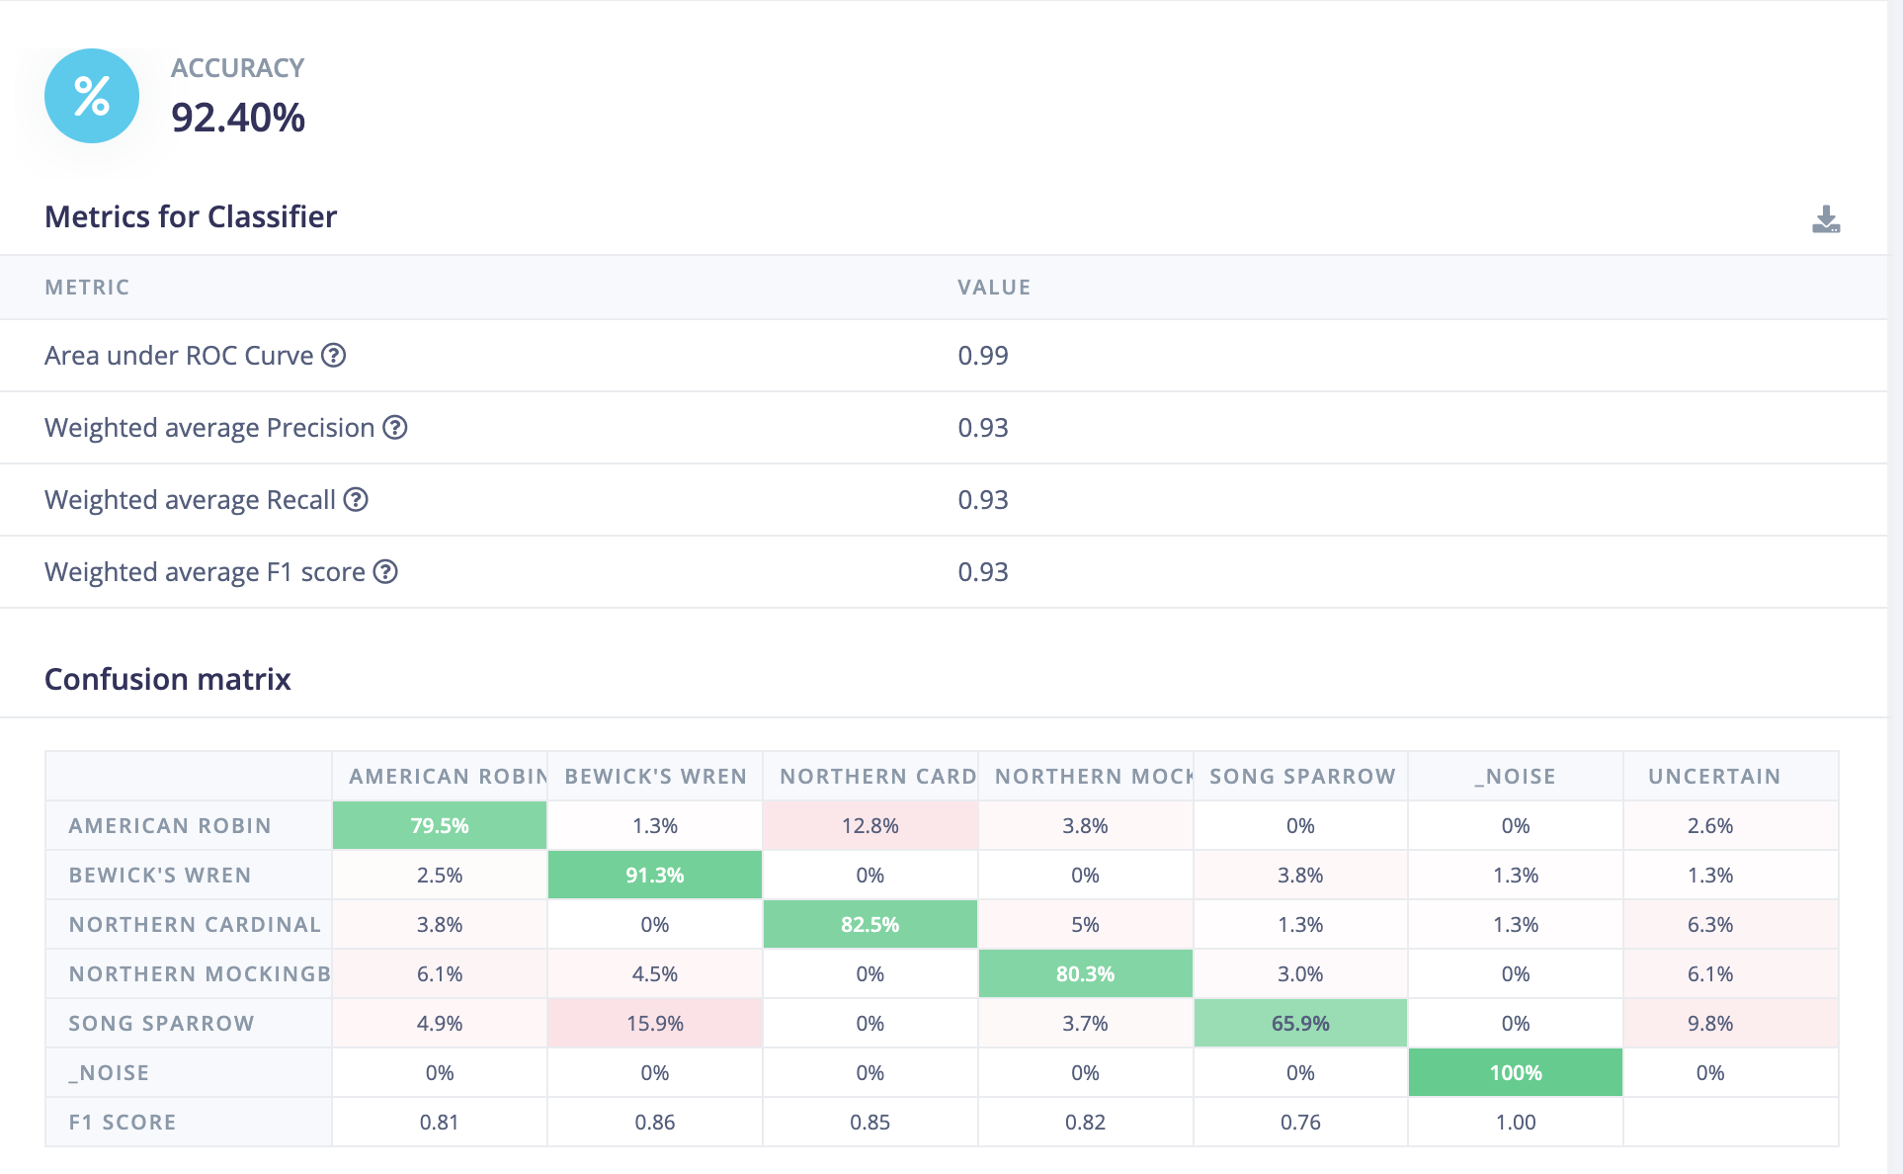
Model Performance - Testing

Slide 9
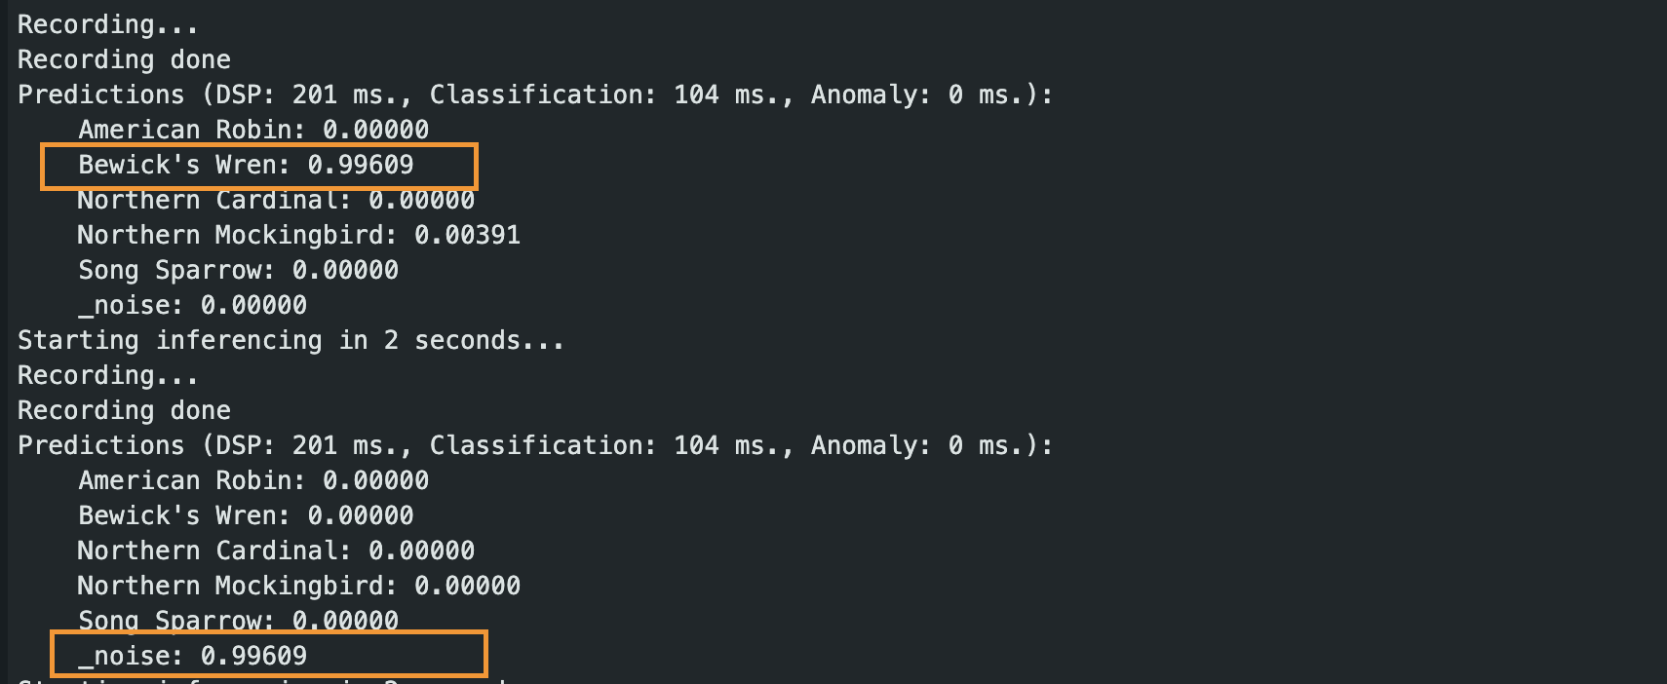
Deployment
We were able to deploy the model on to the Arduino device and correctly identify bird songs.

Slide 10
Extensions and Future Work
Expand Classification
Inclusion of other songs of species and contextual information such has location and time of year
Add calls for species – many birds have different calls for mating, warning, and other social interactions which might be of interest to researchers
Improvements in Model Design
Further reducing model size and energy consumption for monitoring in very remote locations
Training
Expand background noise (e.g. weather conditions – rain/wind)

Slide 11
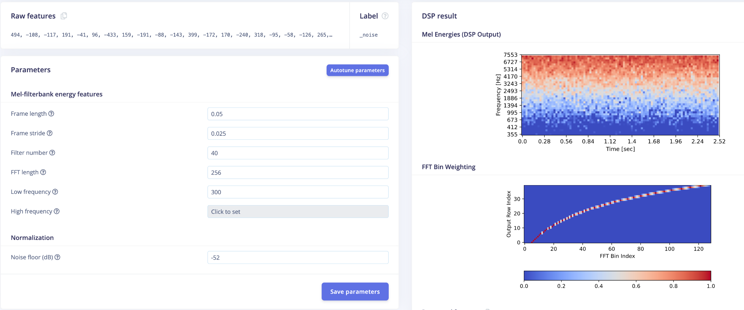
Appendix. a

